Slide 1
Hotel Reservation(SQL)
Deepika
Under the guidence of
MentornesS

Slide 2
Content
Through the use of SQL in this assignment, you will be able to perform an in-depth study of a dataset and develop your practical data analysis abilities. The first step in the procedure is to comprehend the relationships, tables, and columns that make up the dataset. After setting up an appropriate Database Management System (DBMS), such as PostgreSQL or MySQL, you will import the data. You can use SQL to create queries that extract, filter, and aggregate data. You can also use joins to bring together data from different tables.

Slide 3
Overview
The hotel industry relies on data to make informed decisions and provide a better guest experience. In this internship, you will work with a hotel reservation dataset to gain insights into guest preferences, booking trends, and other key factors that impact the hotel's operations. You will use SQL to query and analyze the data, as well as answer specific questions about the dataset.

Slide 4
Dataset Details
Booking_ID: A unique identifier for each hotel reservation.
no_of_adults: The number of adults in the reservation.
no_of_children: The number of children in the reservation.
no_of_weekend_nights: The number of nights in the reservation that fall on weekends.
no_of_week_nights: The number of nights in the reservation that fall on weekdays.
type_of_meal_plan: The meal plan chosen by the guests.
room_type_reserved: The type of room reserved by the guests.
lead_time: The number of days between booking and arrival.
arrival_date: The date of arrival.
market_segment_type: The market segment to which the reservation belongs.
avg_price_per_room: The average price per room in the reservation.
booking_status: The status of the booking.

Slide 5
ANALYSIS

Slide 6
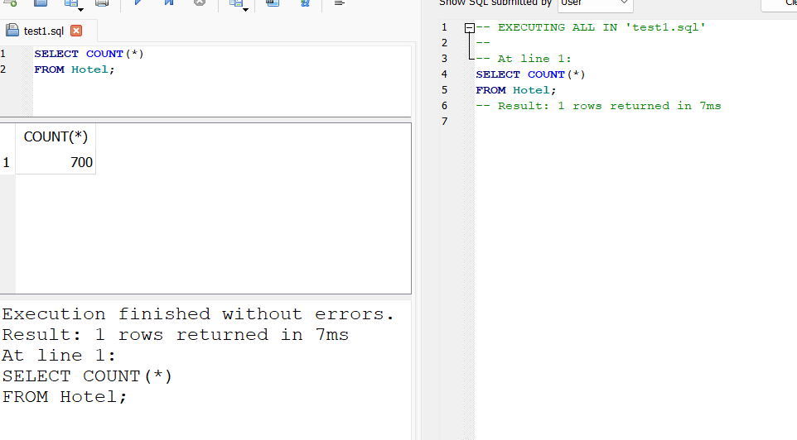
What is the total number of reservations in the dataset

Slide 7
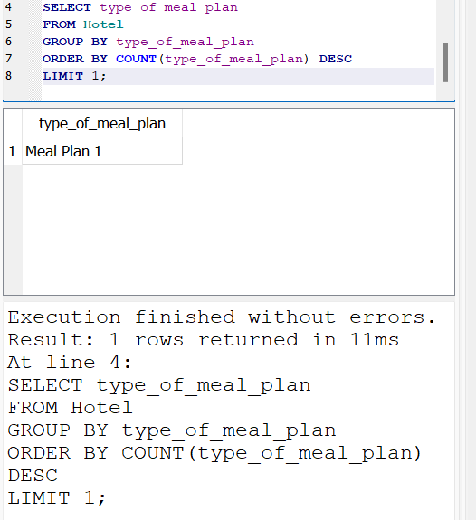
Which meal plan is the most popular among guests

Slide 8
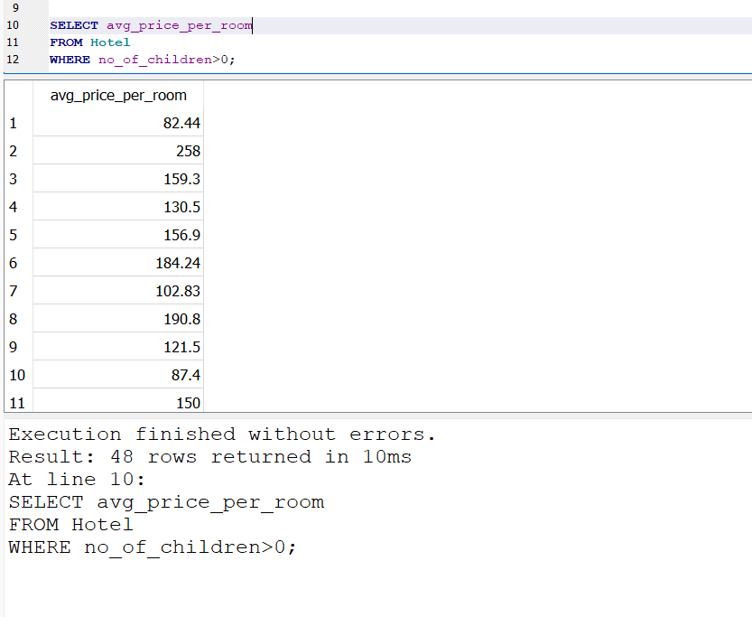
What is the average price per room for reservations involving children

Slide 9
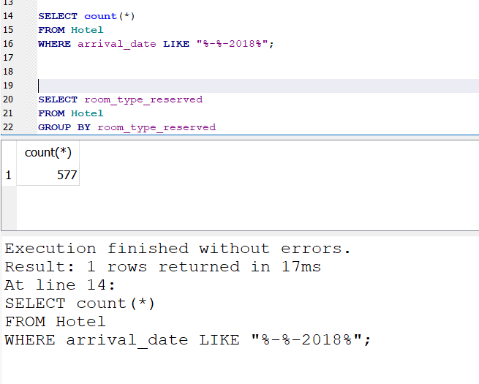
How many reservations were made for the year 20XX (replace XX with the desired year)

Slide 10
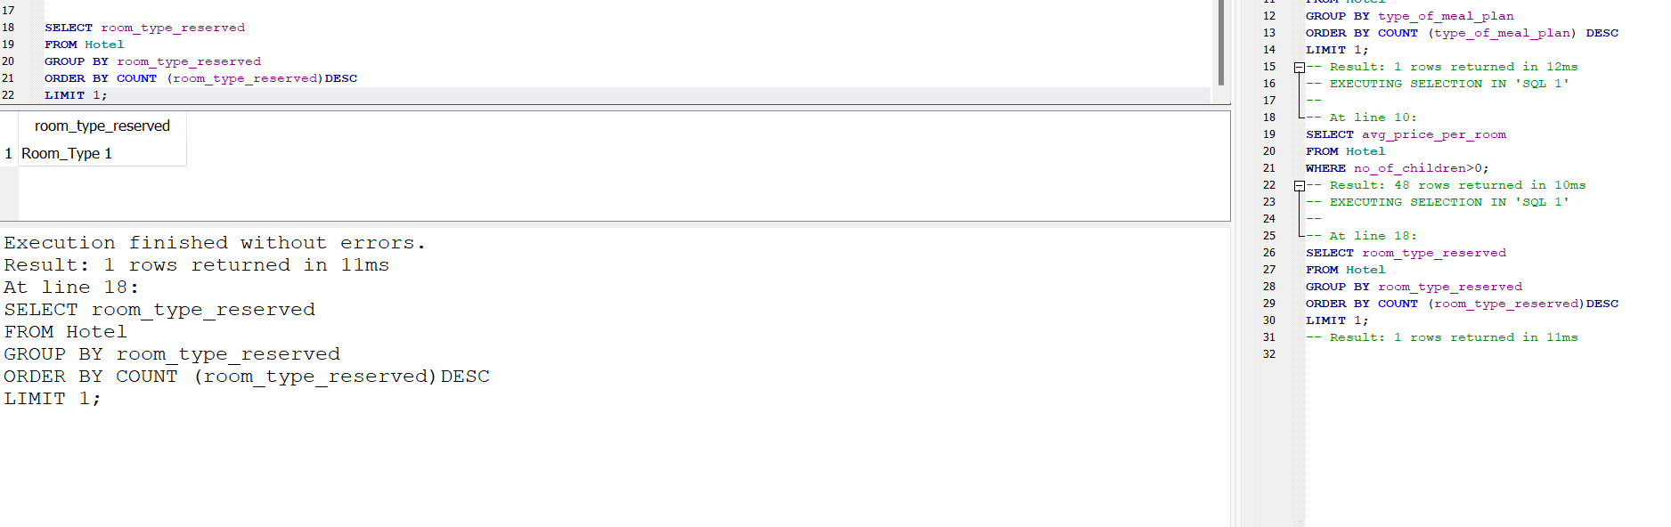
What is the most commonly booked room type

Slide 11
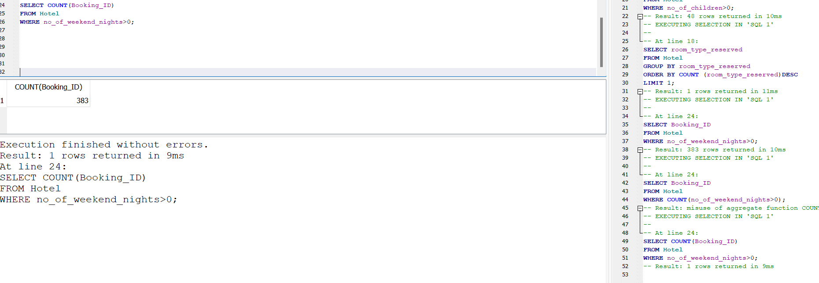
How many reservations fall on a weekend (no_of_weekend_nights > 0)

Slide 12
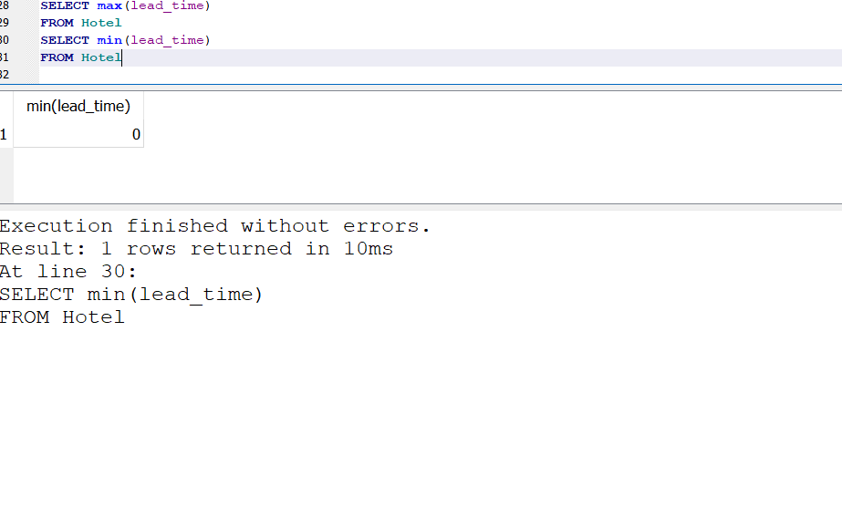
What is the highest and lowest lead time for reservations

Slide 13
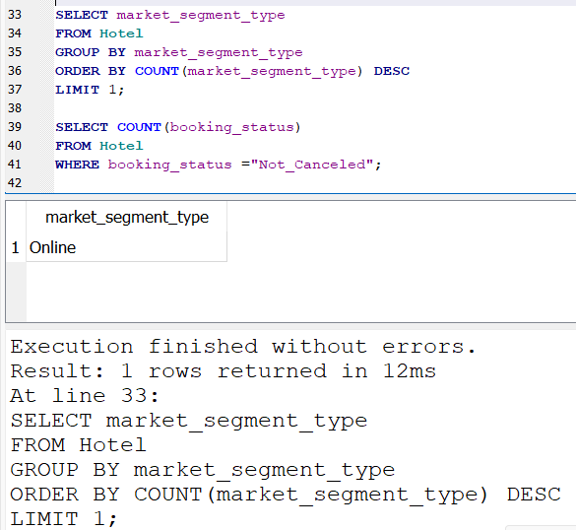
What is the most common market segment type for reservations

Slide 14
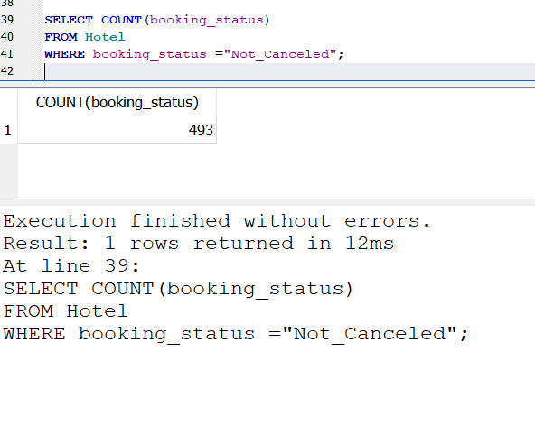
How many reservations have a booking status of "Confirmed"

Slide 15
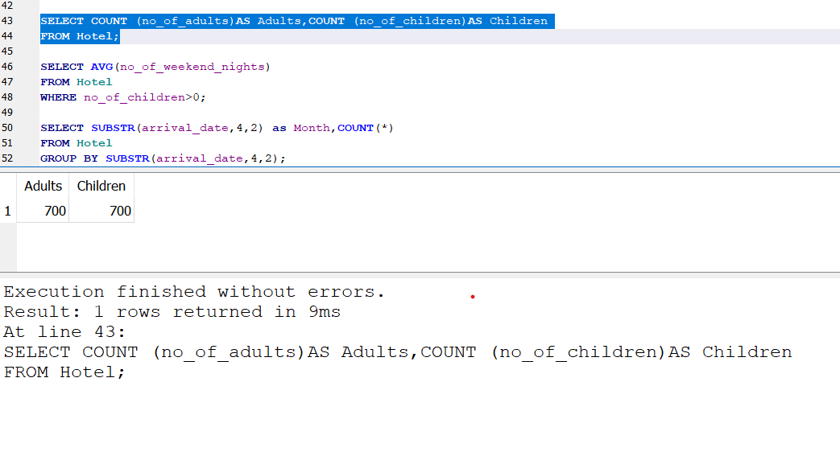
What is the total number of adults and children across all reservations

Slide 16
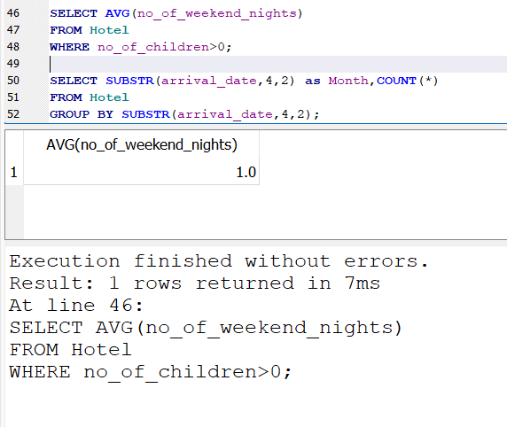
What is the average number of weekend nights for reservations involving children

Slide 17
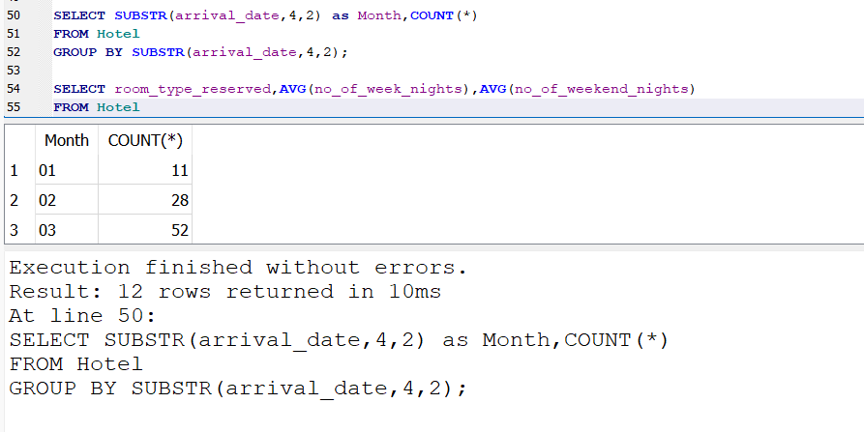
How many reservations were made in each month of the year

Slide 18
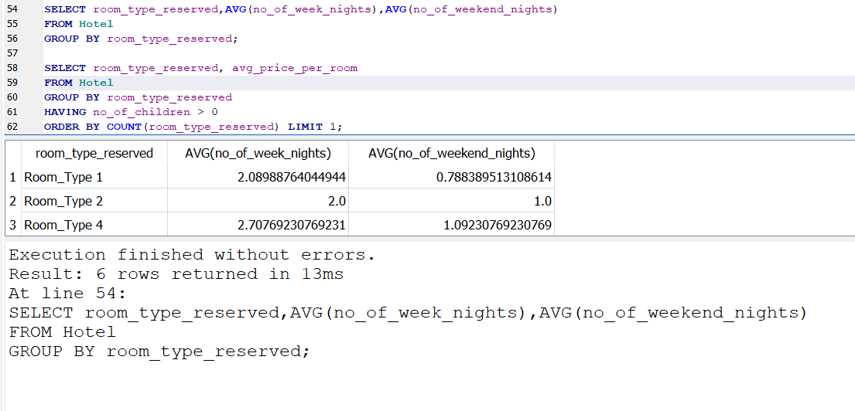
What is the average number of nights (both weekend and weekday) spent by guests for each room type?

Slide 19
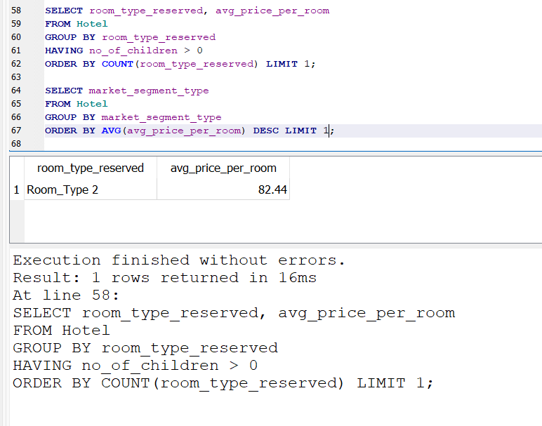
For reservations involving children, what is the most common room type, and what is the average price for that room type

Slide 20
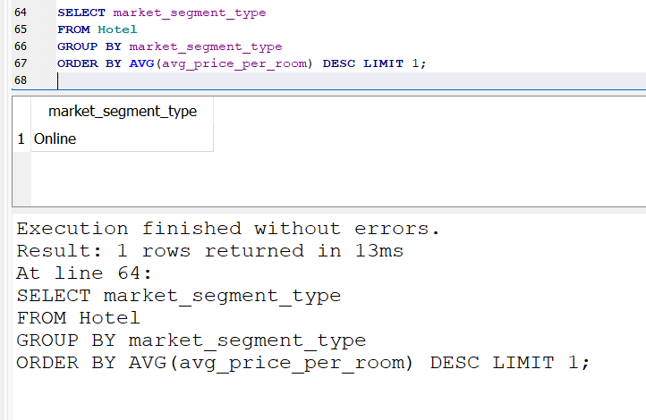
Find the market segment type that generates the highest average price per room.

Slide 21
Conclusion
Finding the answers to particular analytical queries, such recognizing patterns in bookings, consumer behavior, or Service performance indicators, is the aim. Throughout the assignment, I have recorded the inquiries, analyze the data, and compile the conclusions into a report.
When necessary, you will emphasize important findings and encourage data-driven decision-making by utilizing visual aids.

Slide 22
Thank you

